Slide 1
Programming Paradigms
Kaustubh Kulkarni Assistant Professor,
Department of Computer Engineering, KJSCE.

Slide 2
A programming paradigm is a style, or “way,” of programming.
2

Slide 3

Unstructured (Imperative) Programming
Consists of only one main program.
Here “main program” is a sequence of commands or statements which modify data which is global throughout the whole program.
This programming techniques provide tremendous disadvantages once the program gets sufficiently large.
No reusability

Slide 4
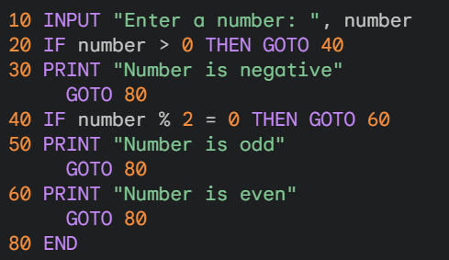
Example (BASIC language)

Slide 5
Structured Programming
Structured programming is a kind of imperative programming where control flow is defined by nested loops, conditionals, and subroutines, rather than via gotos.
Variables are generally local to blocks (have lexical scope).
Early languages emphasizing structured programming: Algol 60, PL/I, Algol 68, Pascal, C, Ada 83, Modula, Modula-2.
Structured programming as a discipline is sometimes thought to have been started by a famous letter by Edsger Dijkstra entitled Go to Statement Considered Harmful.

Slide 6
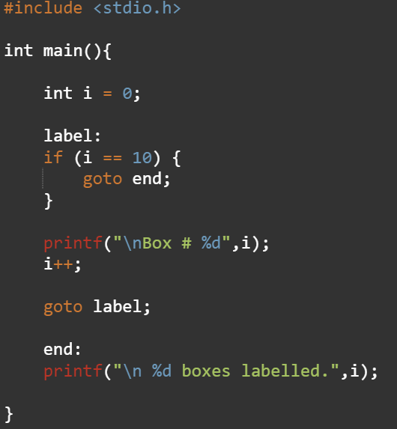
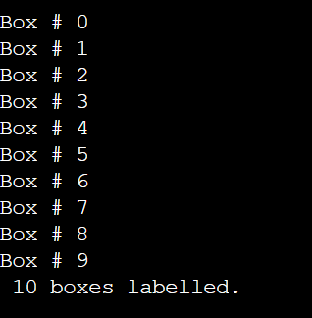
Example of an unstructured paradigm

Slide 7
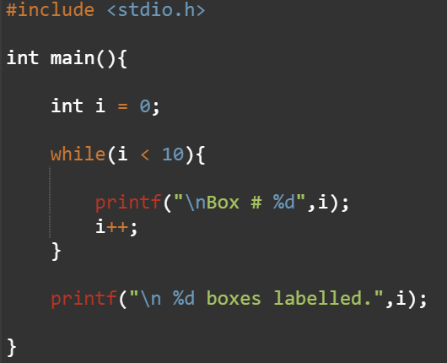
Example of structured paradigm

Slide 8
Procedural Programming
With procedural programming you can combine repeating sequences of statements into one single entity called a procedure
A procedure call is used to invoke the procedure.
The main program coordinates calls to procedures and hands over appropriate data as parameters.
After sequence of statements inside the procedure has been completed, the flow of control proceeds right after the position where the call was made.
Code reuse is possible.
Programs can now be written in a more structured and error free manner.
For example, if a procedure is correct, every time it is used it produces correct results.
Consequently, in cases of errors you can narrow your search to those places which are not proven to be correct.

Slide 9
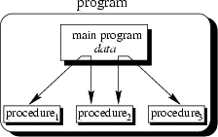
Procedural Programming Illustration 1

Slide 10
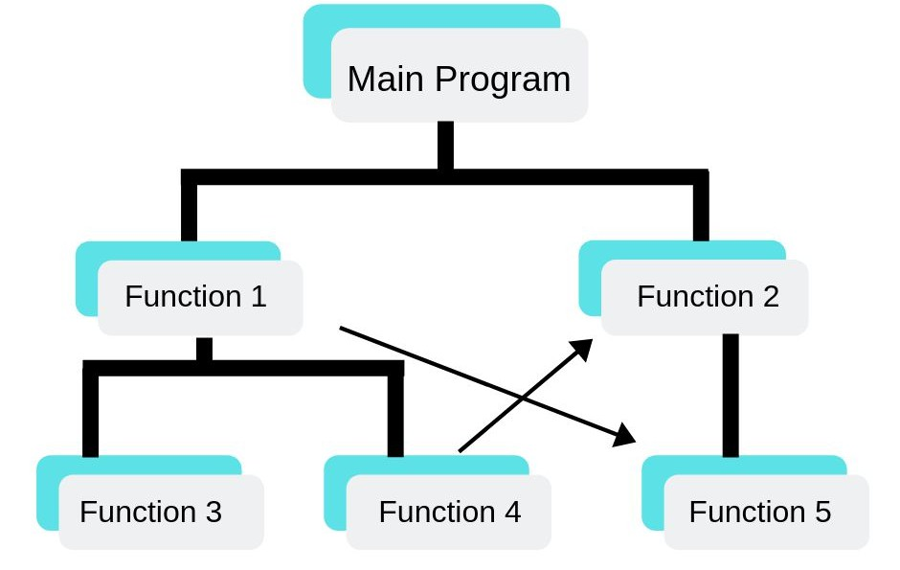
Procedural Programming Illustration 2

Slide 11
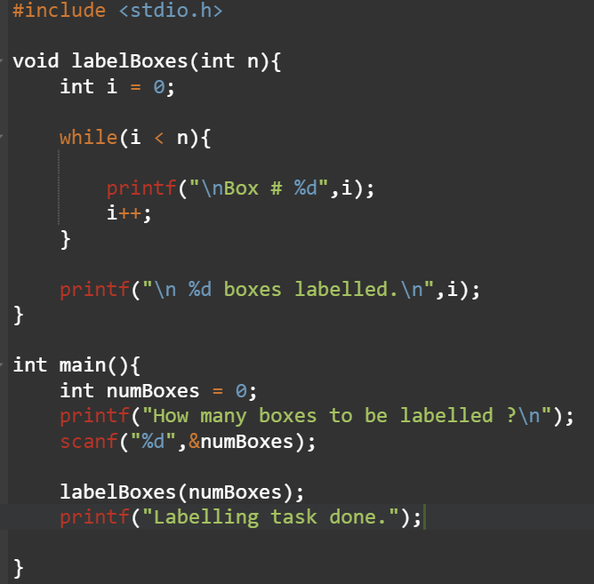
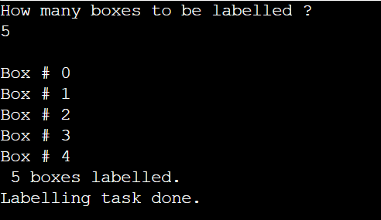
Example of procedural paradigm

Slide 12
Modular Programming
With modular programming procedures of a common functionality are grouped together into separate modules.
A program therefore no longer consists of only one single part.
It is now divided into several smaller parts which interact through procedure calls and which form the whole program.
The main program coordinates calls to procedures in separate modules and hands over appropriate data as parameters.
Each module can have its own data. This allows each module to manage an interna state which is modified by calls to procedures of this module. However, there is only one state per module and each module exists at most once in the whole program.

Slide 13
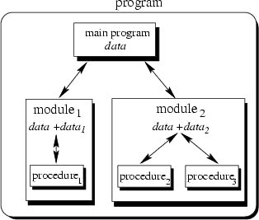
Modular Programming Illustration

Slide 14
Object-Oriented Programming (OOP)
Organizing code around objects that represent real-world entities or concepts.
These objects have data (attributes) and behaviors (methods) that operate on that data.
Code is organized into classes that define the blueprint for objects and their behavior.
Objects are instances of classes.
Data is encapsulated within objects, protecting it from unauthorized access and modification.
Inheritance allows existing code to be reused and extended for new objects.
Encapsulation and interfaces further promote reusability.

Slide 15
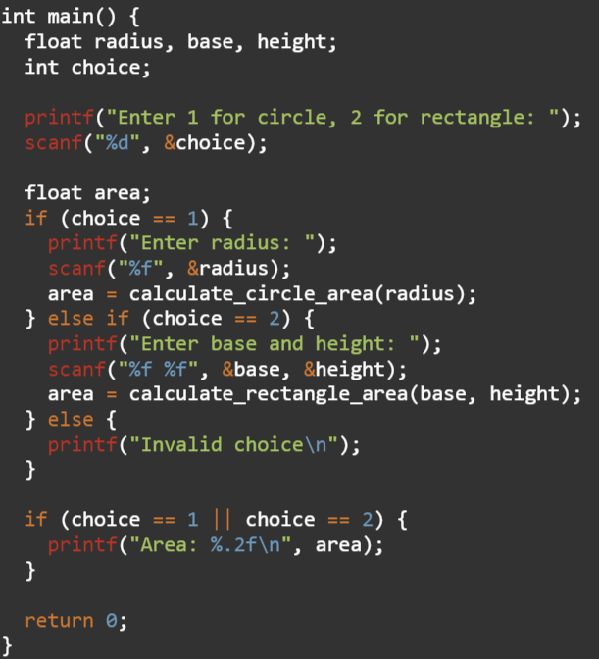
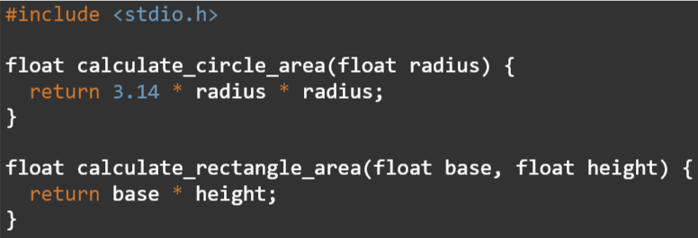
Example : Procedural

Slide 16
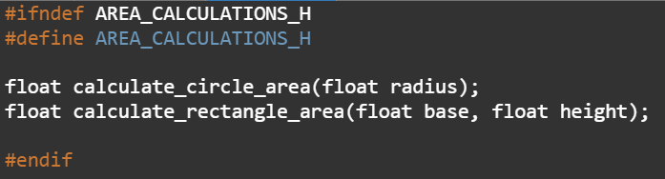
Example : Modular
Header file : area_calculations.h

Slide 17
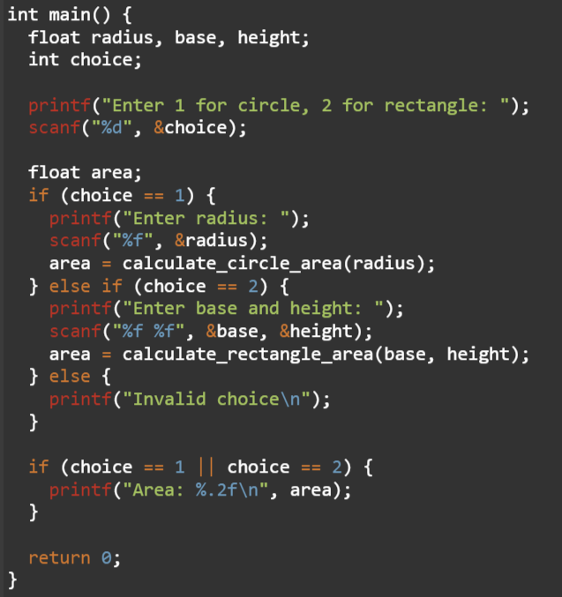

Example : Modular

Slide 18
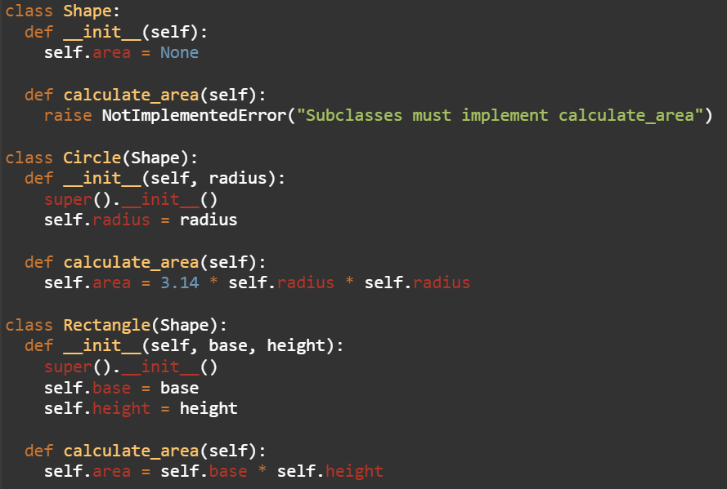
Example of OOP

Slide 19
Feature | Procedural Programming | Modular Programming | Object-Oriented Programming (OOP)
Focus | Program logic flow | Code reusability | Real-world entities and their behavior
Structure | Linear sequence of functions | Independent modules | Classes and objects
Data Organization | Less emphasis on encapsulation | Data encapsulation within modules | Data encapsulated within objects
Code Reusability | Limited | High emphasis | High emphasis, with inheritance

